Slide 1


Sign language detection using computer vision
Presented by:
Manak Rawal (1902900130034)
Kaustubh Ranjan (1902900130027)
Project ID – 2023PJ-IT06

Slide 2
Introduction
What is Sign Language actually?

Slide 3
INTRODUCTION
Communication is basic and necessary for an individual’s life. But some are born with the lack of ability to either convey or collect thoughts. While others encounter mis happenings that carry away their natural capability to communicate.
Use of Sign Languages is a popular & effective way to facilitate the deaf and dumb community, but it has its own limitations too, primarily being the lack of sign language interpreters. This creates two difficulties, one being the non-availability of the sign language interpreters itself and second being the non-reachability of the available interpreters.

Slide 4
Problem statement
What possible issues exist regarding Sign Language?

Slide 5
PROBLEM STATEMENT
Lack of availability of Sign language Interpreters.
Lack of accessible and comparatively accurate gesture recognition solutions.

Slide 6
objective
What is the purpose of this project?

Slide 7
OBJECTIVE
To develop own benchmark Sign Language Dataset.
To develop easy access application for Sign Language Detection.
To achieve better accuracy than existing solutions.

Slide 8
Implementation
How does our model works?

Slide 9
IMPLEMENTATION
OUR PLAIN YET ECLECTIC APPROACH
Extract Holistic Keypoints.
Train LSTM model.
Predict in Real Time.

Slide 10
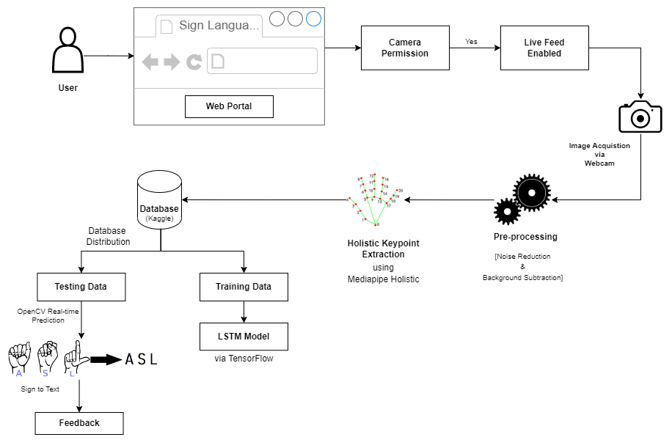
IMPLEMENTATION
ARCHITECTURAL DIAGRAM

Slide 11
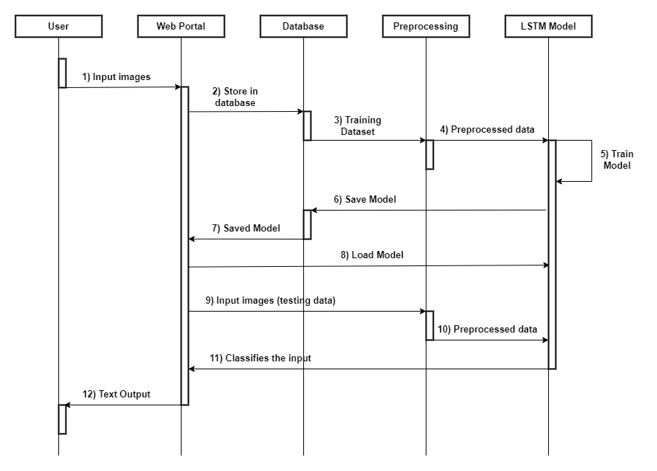
IMPLEMENTATION
SEQUENCE DIAGRAM

Slide 12
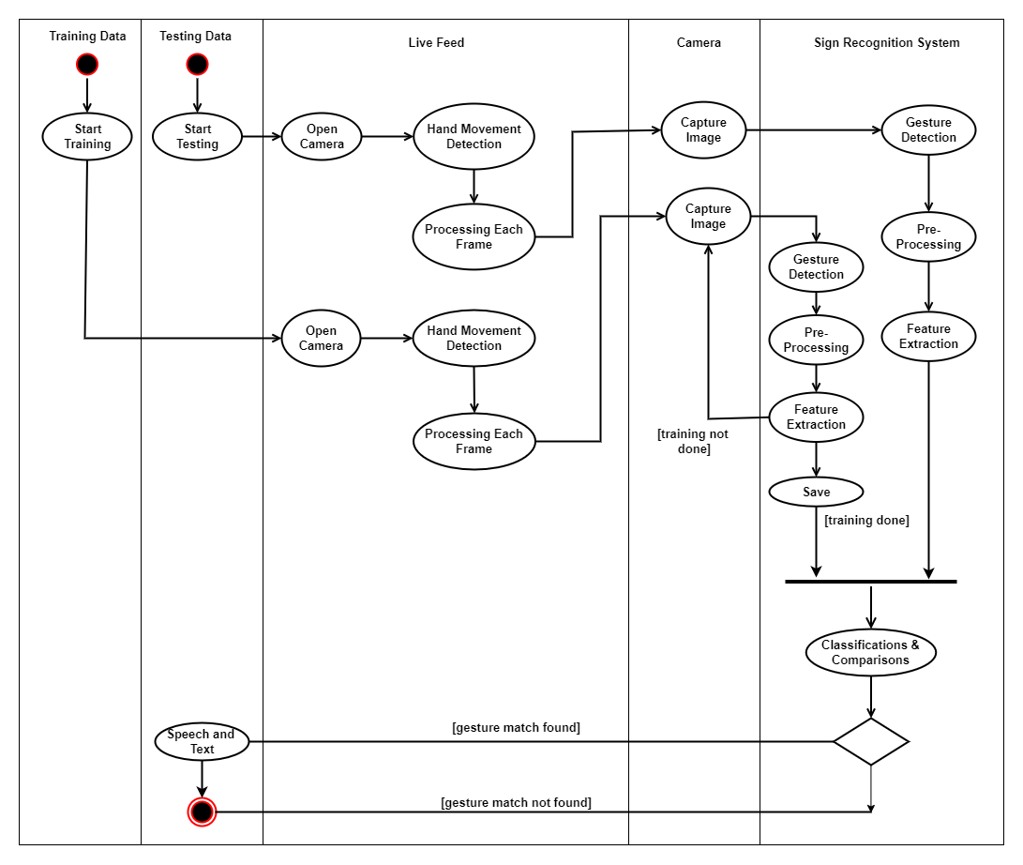
IMPLEMENTATION
ACTIVITY DIAGRAM

Slide 13
methodology
What technologies were required to develop this project?

Slide 14
METHODOLOGY
For the project, our domain analysis primarily focused on comprehending pattern recognition. In order to develop a model capable of recognizing gestures to assist and connect deaf and mute individuals with the world, we employ a comprehensive methodology that combines several techniques. We select the most appropriate machine learning model, considering architectures. The chosen model is then trained on a carefully split dataset, and recognition parameters are optimized. The trained model is evaluated using appropriate metrics such as accuracy and precision to assess its performance.
LSTM Model
MediaPipe Holistic
OpenCV
TensorFlow
NumPy

Slide 15
Project snapshots
What was the development of this project look like?

Slide 16
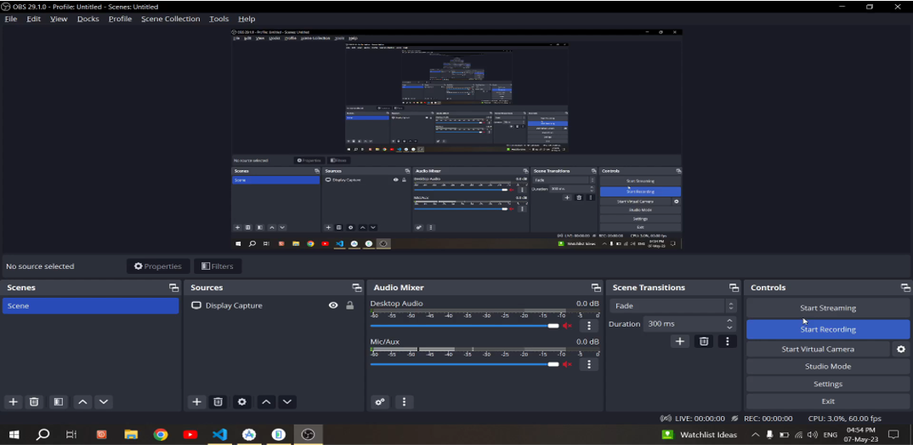
APPLICATION UI

Slide 17
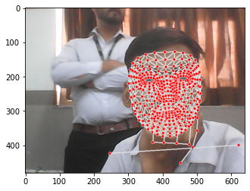
MEDIAPIPE KEYPOINTS EXTRACION TESTING

Slide 18
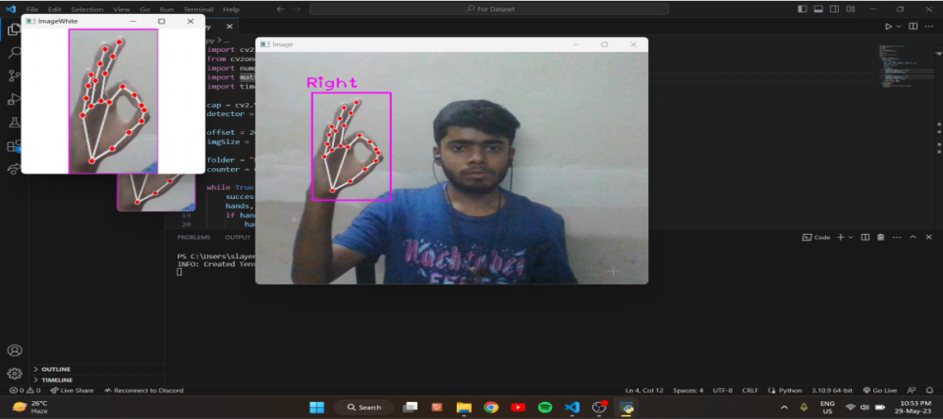
DATASET CREATION

Slide 19
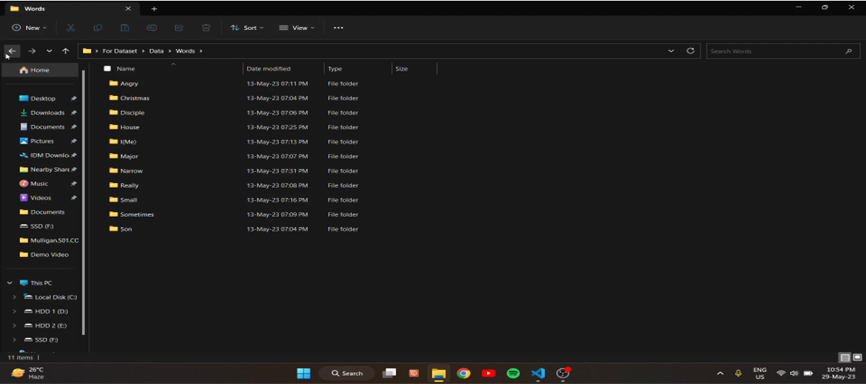
DATASET CREATION

Slide 20
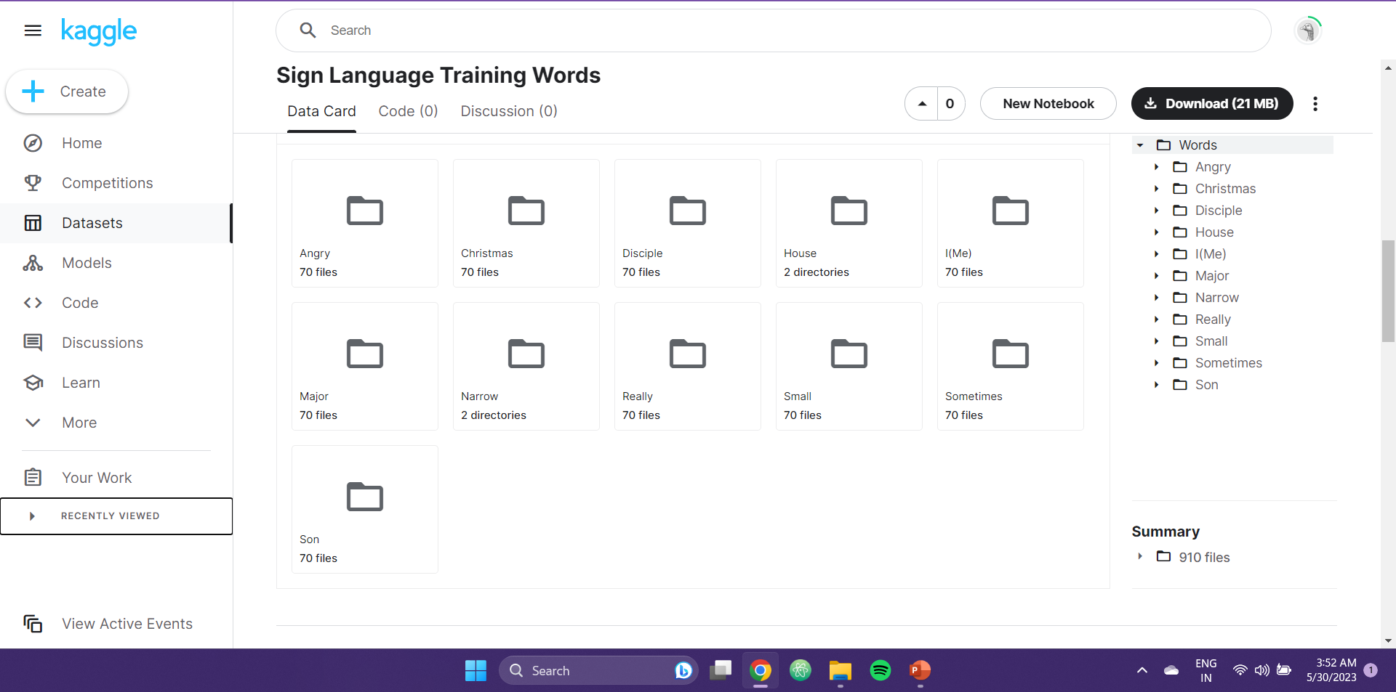
DATASET OVER KAGGLE

Slide 21
Results
What was finally achieved after all this?

Slide 22
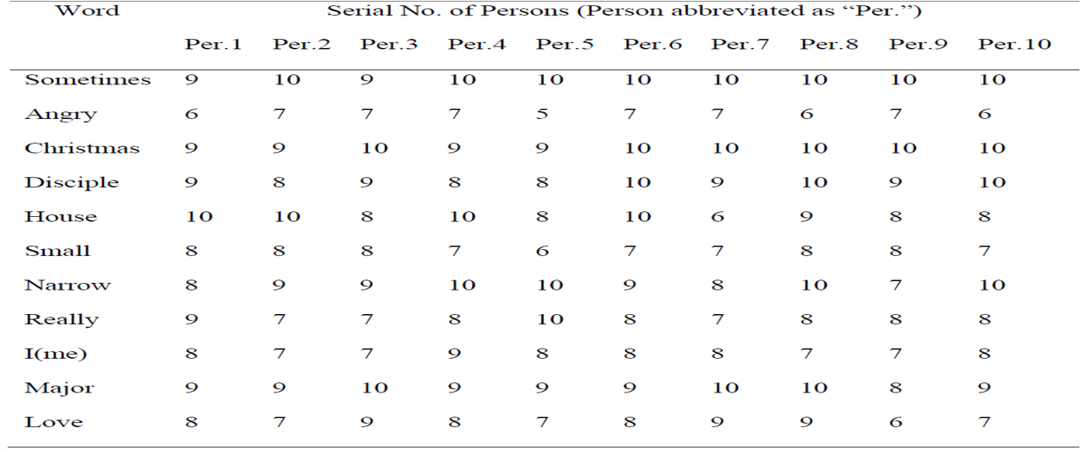
RESULTS

Slide 23
CONCLUSION AND FUTURE SCOPE
What are the possibilities that future holds by this project?

Slide 24
CONCLUSION AND FUTURE SCOPE
Sign Language Recognition is an ongoing area of research that currently lacks widespread implementation. This paper presents a computer vision-based solution that offers improved accuracy and aligns with the relevant knowledge domain. The literature survey in this paper concentrates on exploring different approaches for gesture recognition, providing diverse perspectives on the utilization of various methods and techniques.
In the future, further research will involve conducting a comparative analysis of this study in relation to other existing solutions and newly discovered approaches that incorporate emerging technologies. This analysis will consider the evolving nature of technology and its impact on sign language recognition.

Slide 25
Thank you
Any questions anyone?

